Slide 1

RUMYPET(R U my pet?)
Team Groza
(Presenter) Kim Tae Hong (20132335)
Kim Chan Il (20150577)
Paeng Jin Wook (20154645)
Notes:
Hello everyone, we’re team Groza.
I’m a presenter 팽진욱

Slide 2
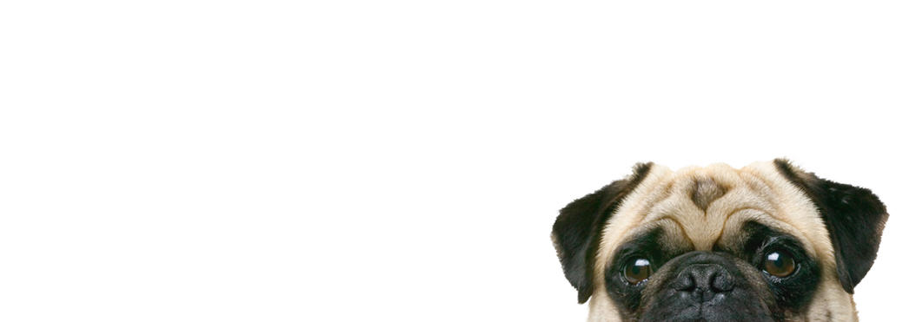
Contents
Schedule & Progress
Problems & Solutions
Plans
Q&A

Slide 3
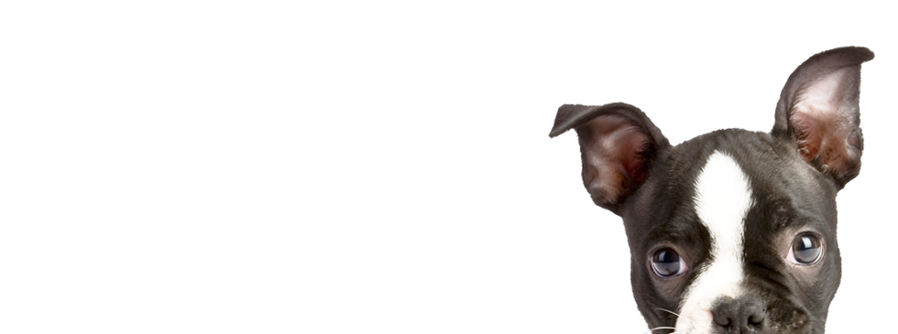
1. SCHEDULE & PROGRESS

Slide 4
SCHEDULE
Week | To-Do (can be changed)
Week 1 | Project goal setting
Week 2 | Propose project
Week 3 | Design: User Interface, System Architectures Setting : Development Environment,
Week 4 | Workshop for collecting data set( Dog cafe, park, .. etc) Hong : Launching AWS server environment Chan : Applying Design to Android Studio Paeng : Develop Pre-processing Method and apply it to Fingerprint picture.
Week 5 | Hong : build the basic code in the server Chan : Develop Android Application Paeng : Apply Pre-processing method to the dog’s nose picture using python opencv.
Week 6 | Hong : Complete the developing basic Server Core Chan : Develop Android Application Paeng : Develop Feature Detecting & Matching
Week 7 | Hong : connect the server and application Chan : Complete Android Application Paeng : Refactoring Code to get good performance
Week 8 | Midterm Examination
4
Notes:
This is our schedule.
This week, we’re supposed to go workshop to collect the data of dog nose.
Because we don’t have any data.

Slide 5
SCHEDULE
Week 9 |  | Hong : sync with server Paeng : sync with client Chan : Intermediate check of our development status
Week 10 |  | Hong : complete the server and android application. Paeng : complete the Application UI Chan : complete the algorithm.
Week 11 |  | We will meet together and feedback each other’s code.
Week 12 |  | Hong : Implement improvement factor at Server Paeng : Implement improvement factor at algorithm Chan : Implement improvement factor at application UI
Week 13 |  | First Demonstration and feedback
Week 14 |  | First Revising our project
Week 15 |  | Final Demonstration
Week 16 |  | Final Examination
5
Notes:
This is the schedule later.

Slide 6
Role of this week
Week 6 | Hong : Complete the developing basic Server Core Chan : Develop Android Application Paeng : Develop Feature Detecting & Matching
6
Notes:
As I said, we’re supposed to go workshop to collect some data.
But, It is so simple, We don’t want you to blame me.
*So we did some extra works.
--ppt read--
We will gonna show you the modified schedule next week.

Slide 7

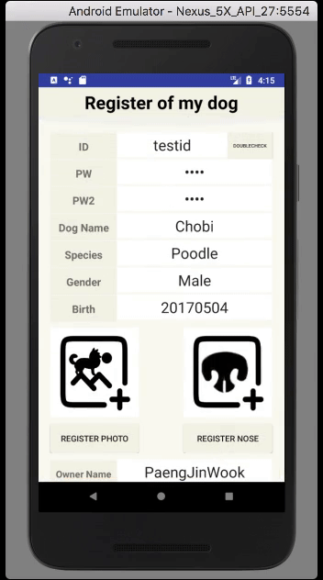
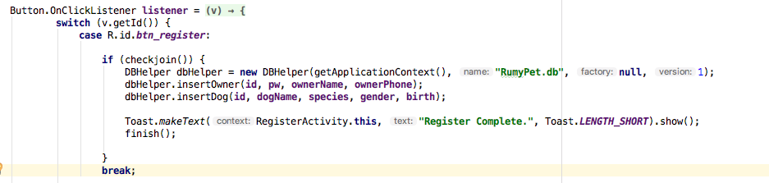
Schedule & Progress – Kim Chan Il
“Made Register & Login Function Using Inner DB”
7
Notes:
This is the UI Deisign we did last week.
Using this, Chan il Kim applied this into Android Studio.

Slide 8
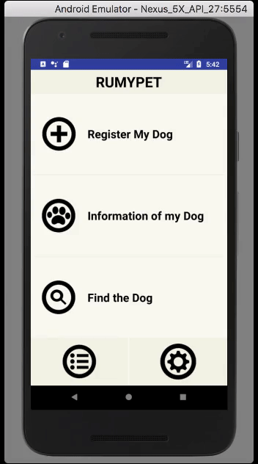
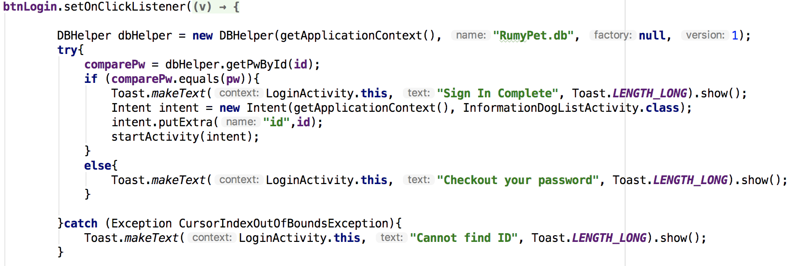
Schedule & Progress – Kim Chan Il
“Made Register & Login Function Using Inner DB”
8
Notes:
This is the UI Deisign we did last week.
Using this, Chan il Kim applied this into Android Studio.

Slide 9
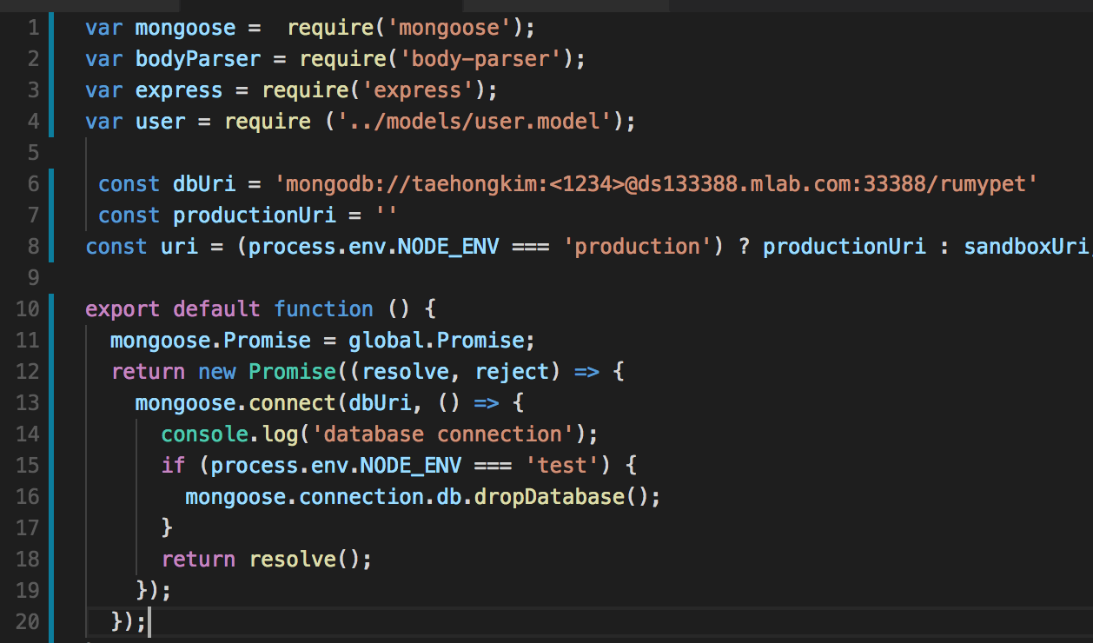
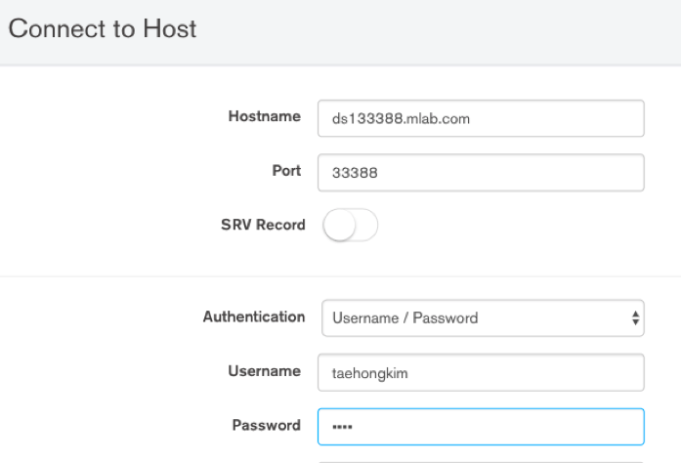
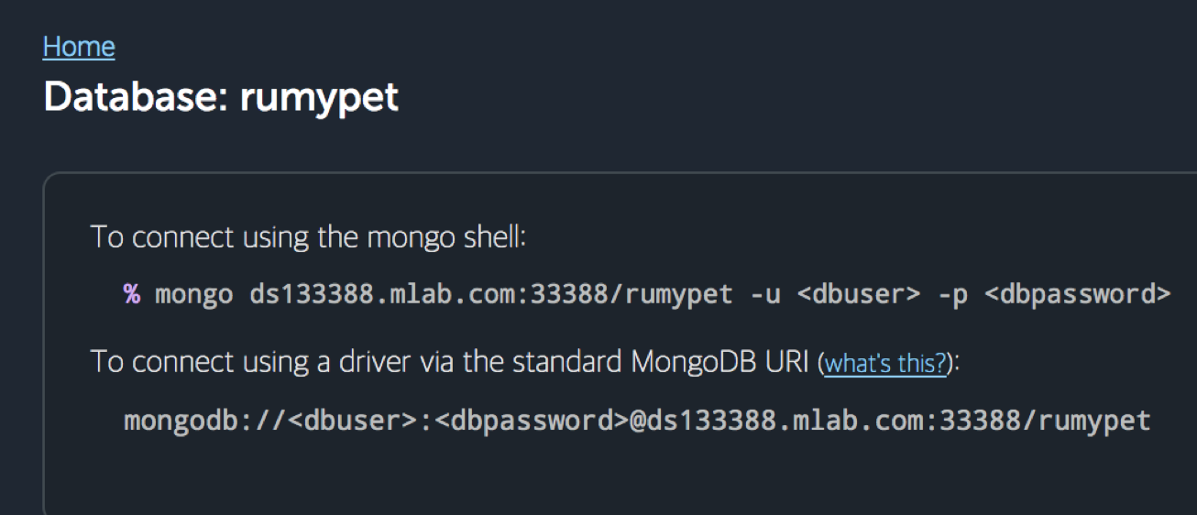
Schedule & Progress – Kim Tae Hong
“Using the MongoDB
Connect the Server and Database”
9
Notes:
Left one is the simple python code for testing
Right one is the return value that came from the python code. We get the string through the server using nodejs.

Slide 10
Schedule & Progress – Paeng Jin Wook
“Develop the Method to get matching Score”
10
Notes:
Next, This is what I have done. I developed pre-processing method and applied it to fingerprint picture.
I used OpenCV – Python, and these are the version of them.
The principle of Fingerprint recognition and Dog Nose Recognition is very Similar.

Slide 11
Schedule & Progress – Paeng Jin Wook
“The Source Code of SIFT Function”
11
Notes:
Next, This is what I have done. I developed pre-processing method and applied it to fingerprint picture.
I used OpenCV – Python, and these are the version of them.
The principle of Fingerprint recognition and Dog Nose Recognition is very Similar.

Slide 12
Schedule & Progress – Paeng Jin Wook
“The Matching Score of Same dog”
Matching Score : 105
12
Notes:
Next, This is what I have done. I developed pre-processing method and applied it to fingerprint picture.
I used OpenCV – Python, and these are the version of them.
The principle of Fingerprint recognition and Dog Nose Recognition is very Similar.

Slide 13
Schedule & Progress – Paeng Jin Wook
“The Matching Score of Different dog”
Matching Score : 5
13
Notes:
Next, This is what I have done. I developed pre-processing method and applied it to fingerprint picture.
I used OpenCV – Python, and these are the version of them.
The principle of Fingerprint recognition and Dog Nose Recognition is very Similar.

Slide 14
2. PROBLEMS & SOLUTION

Slide 15
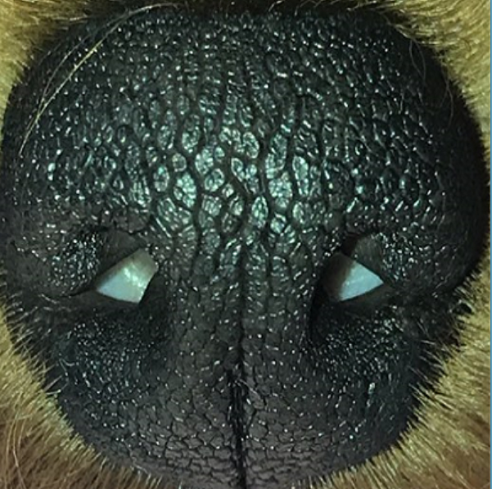
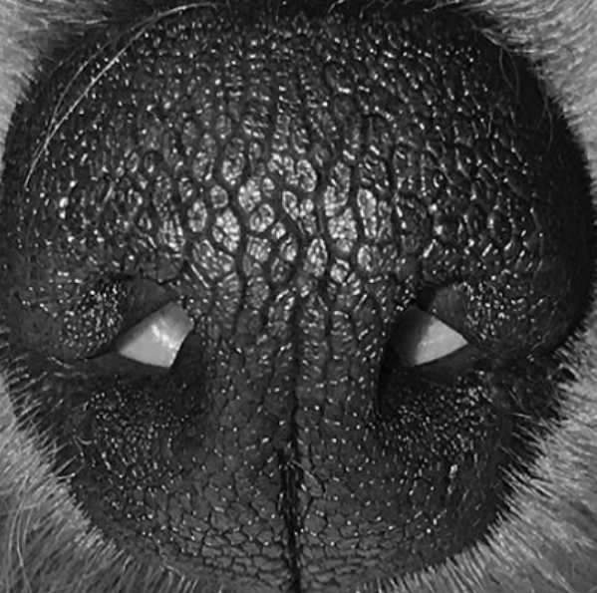
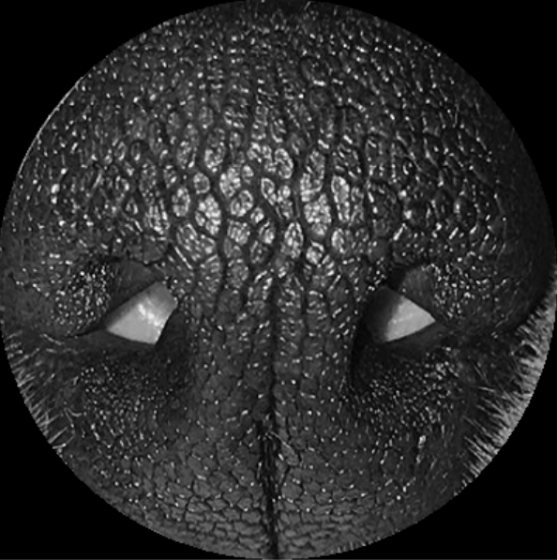
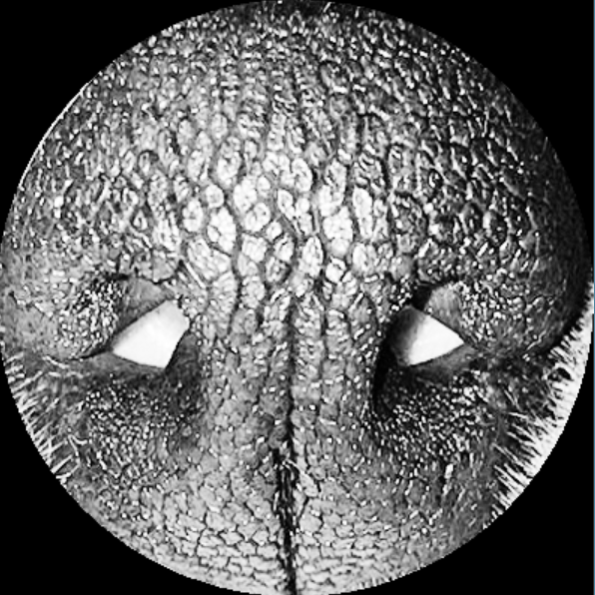

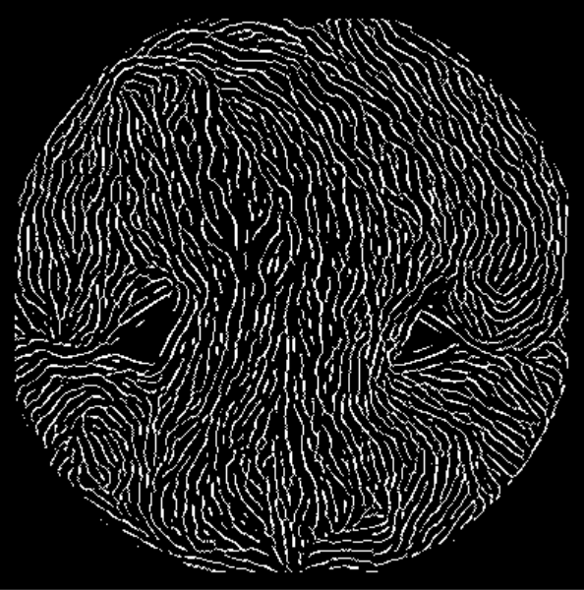

PROBLEMS & SOLUTIONS
Problem 1
We can’t get a good performance with the Preprocessing code of fingerprint.
Raw image
gray image
mask image
Eq image
filter image
thin image
This was the Preprocessing result of Last week
15
Notes:
--ppt reading--
Now, we have our own server!

Slide 16
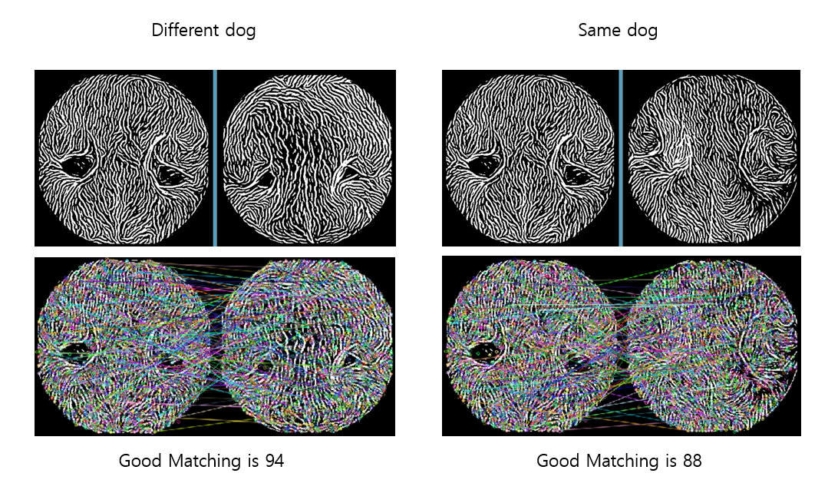
PROBLEMS & SOLUTIONS
Problem 1
We can’t get a good performance with the Preprocessing code of fingerprint.
The difference is not big...
16
Notes:
--ppt reading--
Now, we have our own server!

Slide 17
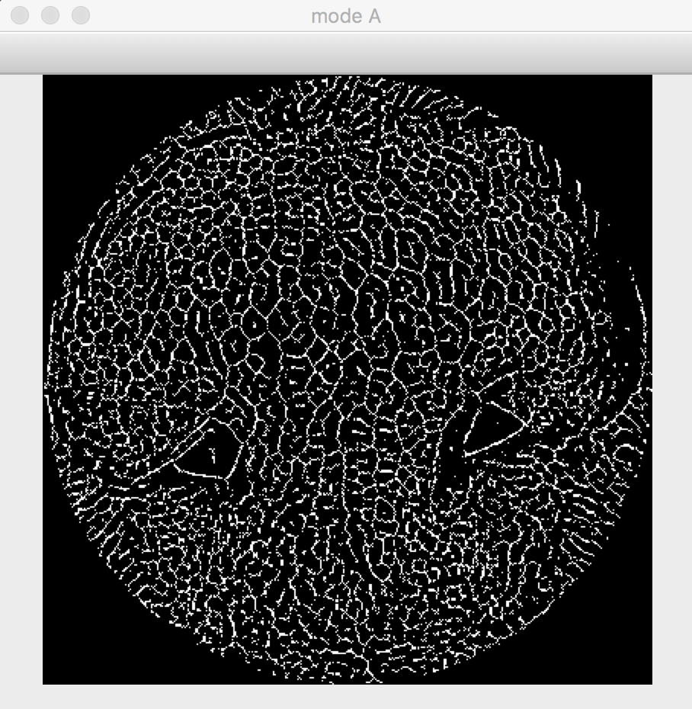
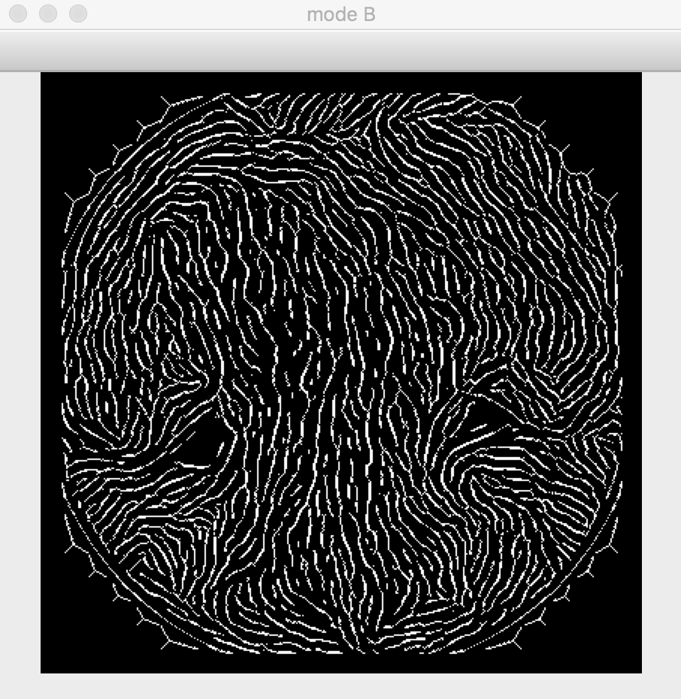
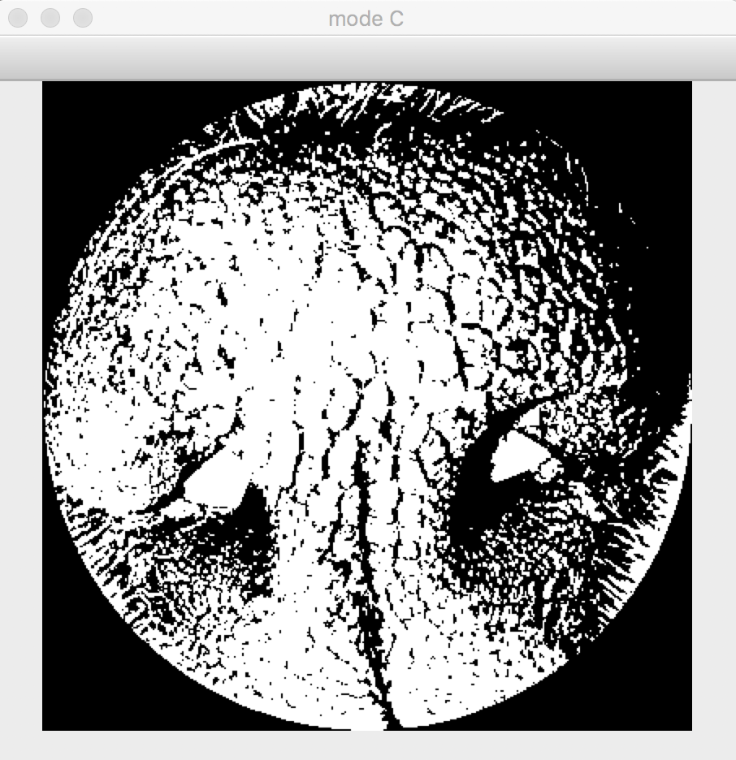
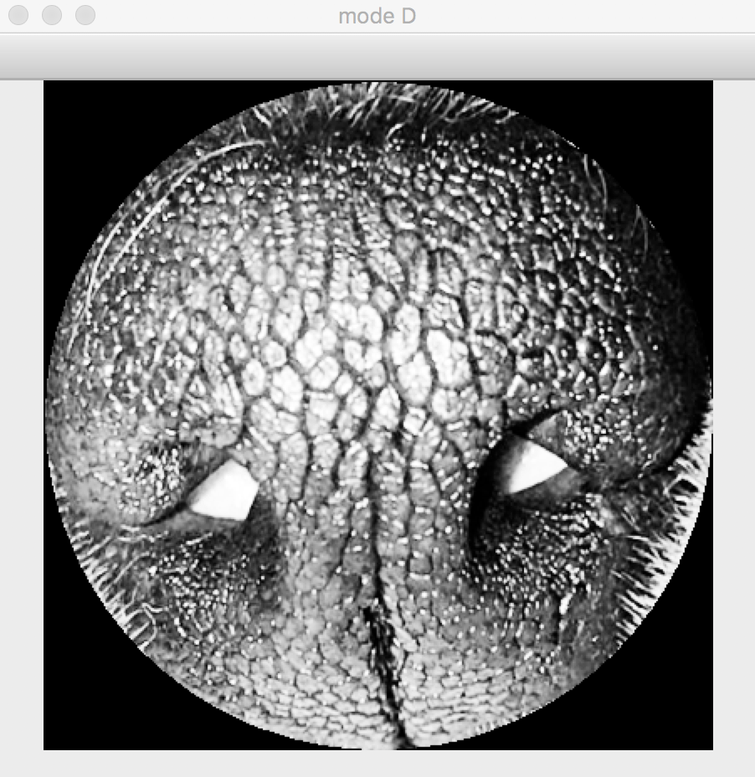
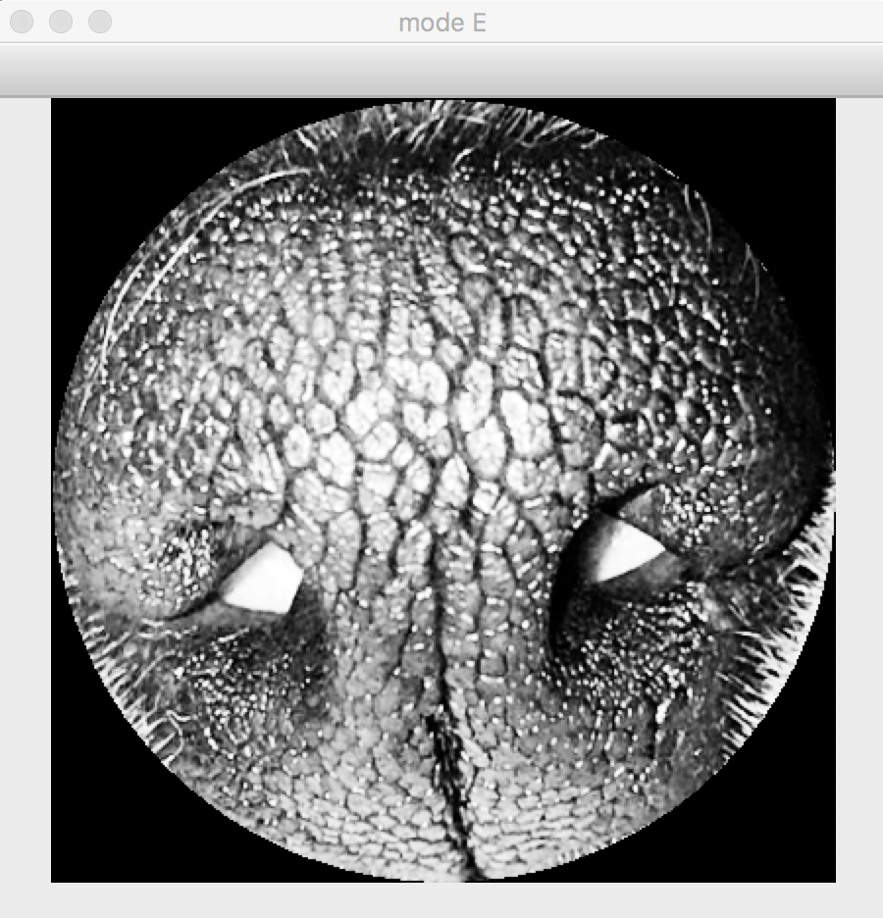

PROBLEMS & SOLUTIONS
Solution for Problem 1
We tried various of Preprocessing Method.
fin = fining
bi = binarization
mask = masking image
eq = equalization
thin = thinning
eof = edge orientation filter
A) image → fin → bi → mask → thin
B) image → gray → mask → eq → eof → thin
C) image → gray → mask → eq → bi
D) image → gray → mask → eq
E) image → gray → mask → eq → eof
17
Notes:
--ppt reading--
Now, we have our own server!

Slide 18
PROBLEMS & SOLUTIONS
Solution for Problem 1
We tried various of Preprocessing Method.
Finally, we find out the Mode D was has the best performance.
D) image → gray-scaling → masking → equalization
Original Image
Gray-Scaling
Masking
Equalization
18
Notes:
--ppt reading--
Now, we have our own server!

Slide 19
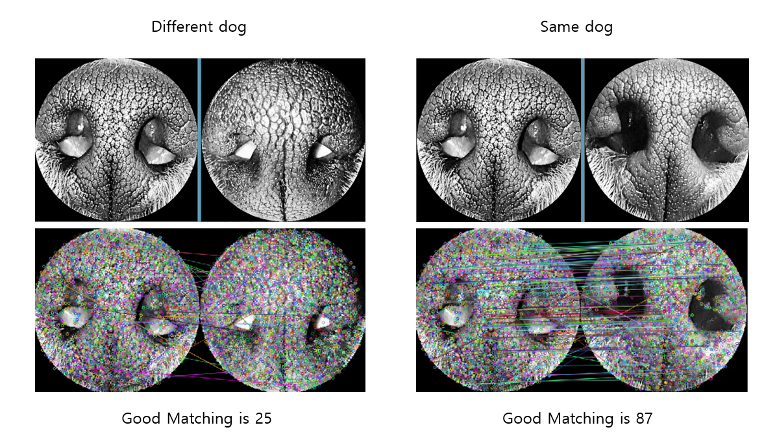
PROBLEMS & SOLUTIONS
Solution for Problem 1
We tried various of Preprocessing Method.
Finally, we find out the Mode D was has the best performance.
D) image → gray-scaling → masking → equalization
19
Notes:
--ppt reading--
Now, we have our own server!

Slide 20
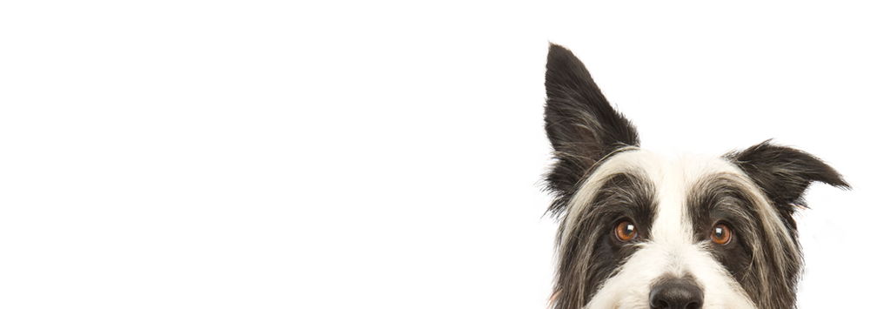
3. PLANS

Slide 21
PLANS for next week
Week 7 | Hong : connect the server and application Chan : Complete Android Application Paeng : Refactoring Code to get good performance
21
Notes:
ppt reading

Slide 22
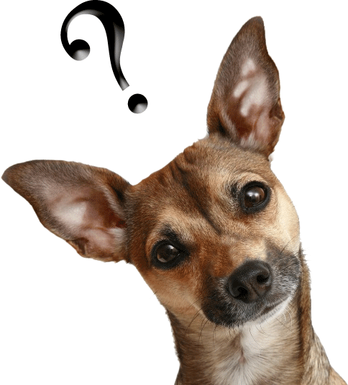
Q&A

Slide 23
Thank you!

